Slide 1
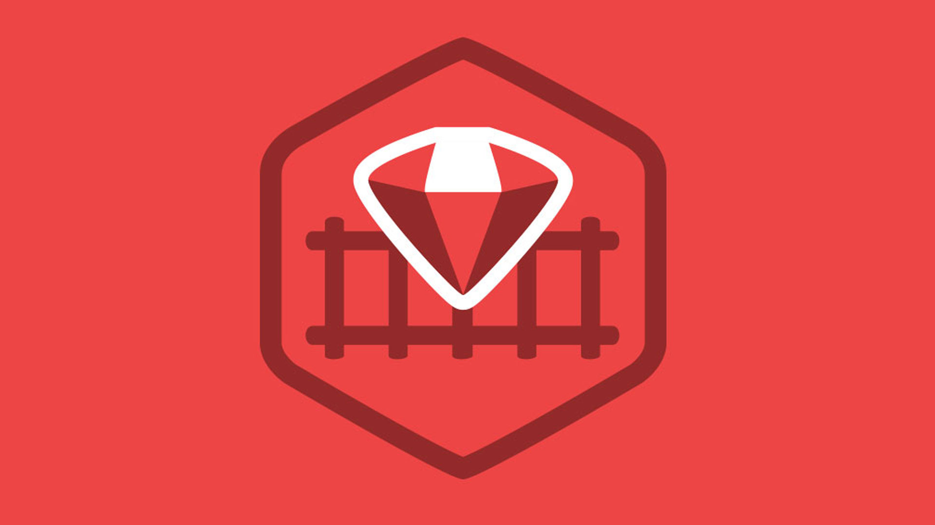
Ruby on Rails

Slide 2
About today…
Ruby on Rails
Devise : User Authentication

Slide 3

Devise
User Authentication

Slide 4



Add Devise to Gemfile
Save the file and then run

Slide 5

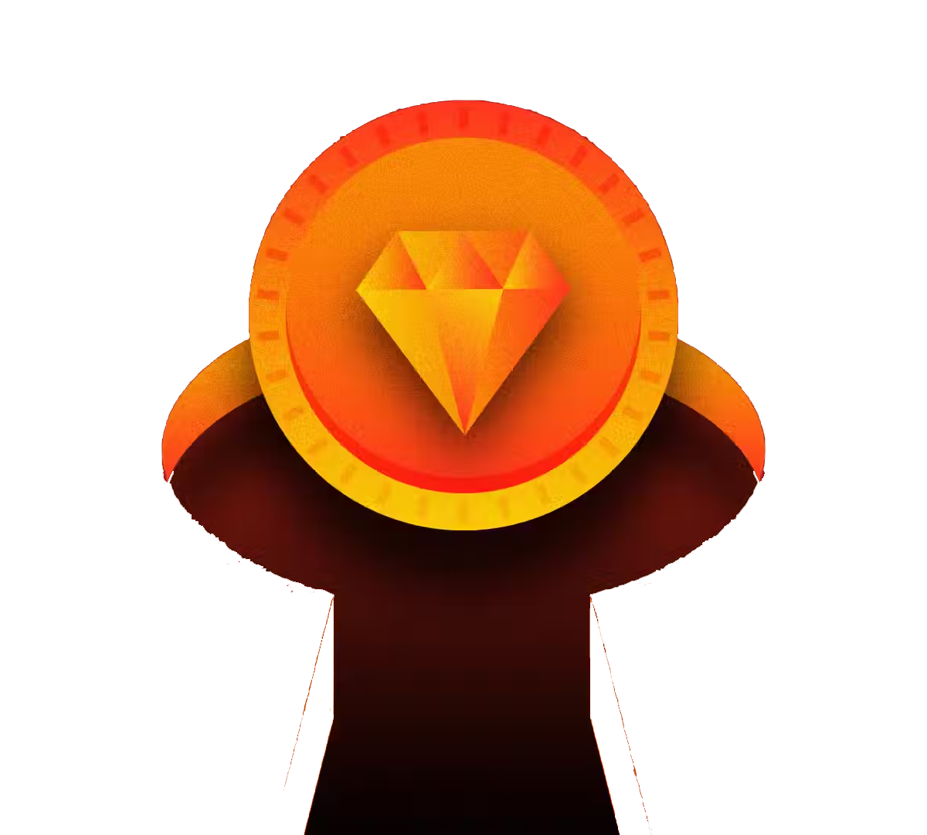
Install Devise
Run the Devise generator to set up its configuration and models
This command will create an initializer file (config/initializers/devise.rb) where you can configure Devise.

Slide 6

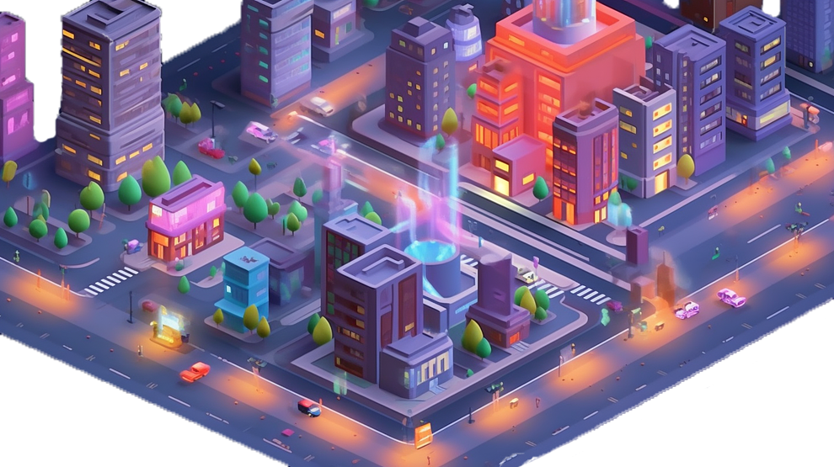
Generate Devise Models
Devise requires a model to authenticate users. Let's generate one for the model name User
This command will generate the User model with necessary configurations and migrations

Slide 7

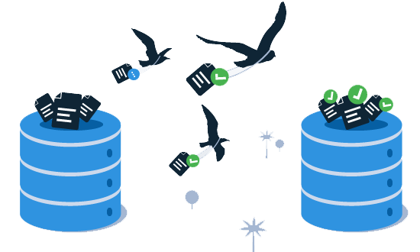
Run Migrations
Now, migrate the database to create the necessary tables for Devise
This command will generate the User model with necessary configurations and migrations

Slide 8
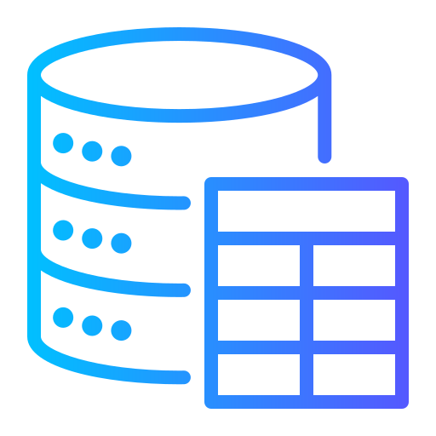
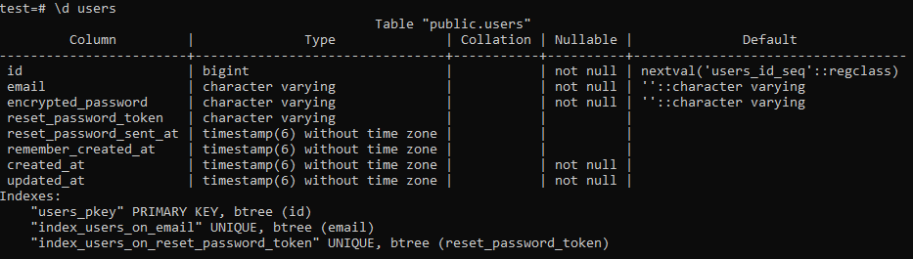
User table
Now, you can see the ‘users’ table in database

Slide 9
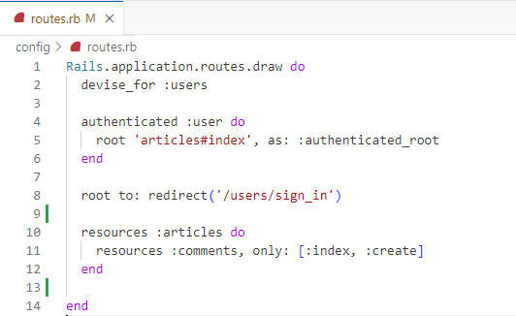
Configure Routes
Devise automatically adds routes for authentication, but you can customize them in config/routes.rb:
If a user is authenticated (authenticated :user block), they will be directed to the articles#index route
If not authenticated, they will be redirected to the users/sign_in path (the login page)

Slide 10

Add Authentication Helpers
You can add helpers to restrict access to certain parts of your application in controllers

Slide 11

Customize Views
If you need to customize the authentication views, you can generate them

Slide 12
Add Logout button
In the main page, add a LogOut button to make the destroy the current login session

Slide 13

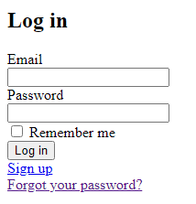
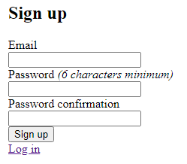
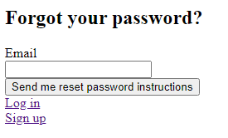
Start rails Server
Access Devise Routes
Navigate to http://localhost:3000

Slide 14


Slide 15

What is Devise in Ruby on Rails?
How do you install Devise in a Rails application?
Which command is used to generate Devise views?
How do you add Devise to a model (e.g., User)?
What is the default URL for signing in a user with Devise?

Slide 16

Task 1
Add Devise into your Rails app for user authentication by following these steps

